Slide 1
FLAGS

Slide 2
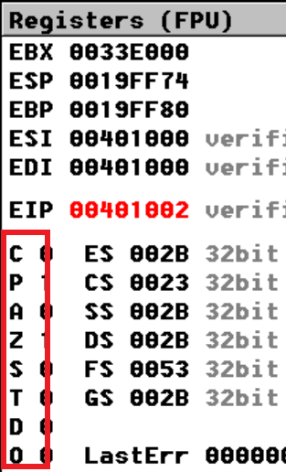
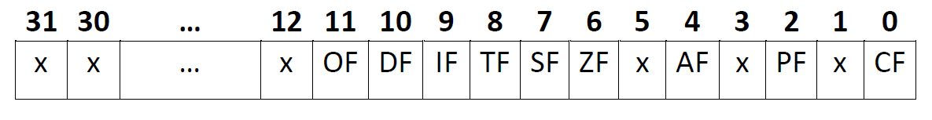
The flags (from EFLAGS register)
A flag is an indicator represented on one bit, so 1 means that the flag is set and 0 means that the flags is not set.
For x86 the EFLAGS register (the status register) has 32 bits but only 9 are actually used (the bits from the eflags are numbering from right to left, so from 0 to 31). And only bits from specific position can be addressed using particular instructions.

Slide 3
Classification of flags
1. Status flags - reflect the outcomes of arithmetic and/or logical operations performed by the CPU
Carry flag
Parity flag
Auxiliary flag
Zero flag
Sign flag
Overflow flag
2. Control flags - control the CPU’s operation (break, interrupt the execution of an operation)
Direction flag
Trap Flag
Interrupt flag

Slide 4
Carry Flag
The Carry flag (CF) is set when the result of an unsigned arithmetic operation is too large to fit into the destination (the result of an arithmetic operation on unsigned numbers is out of range).
Range of 8-, 16-, and 32-bit unsigned numbers:
8 bits (byte): 0 to 255 (Card byte = 256)
16 bits (word): 0 to 65,535 (Card word = 65536)
32 bits (doubleword): 0 to 4,294,967,295
Uses of carry flag
To propagate carry/borrow in quadword addition/subtraction (or doublword in combination of registers)
To detect overflow

Slide 5
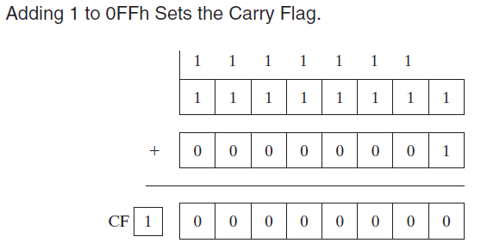
Carry Flag Examples: ADD (1)
When adding two unsigned integers, the Carry flag is a copy of the carry out of the MSB (most significant bit) of the destination operand.
CF = 1 when the sum exceeds the storage size of its destination operand.
The carry out of the highest bit position of AL is copied into the Carry flag.
Example:
mov al, 11111111b ;(0FFh)
add al, 1 ; AL = 00, CF = 1
ADD sets the Carry flag because
the sum (1 0000 0000) is too large for AL
Notes:
The Carry, Zero, Sign, Overflow, Auxiliary Carry, and Parity flags are changed according to the value that is placed in the destination operand.
Addition and the Carry Flag: When adding two unsigned integers, the Carry flag is a copy of the carry out of the MSB of the destination operand. Intuitively, we can say CF 1 when the sum exceeds the storage size of its destination operand.
The carry out of the highest bit position of AL is copied into the Carry flag.
ADD sets the Carry flag because
the sum (100h) is too large for AL:
mov al,0FFh
add al,1 ; AL = 00, CF = 1

Slide 6
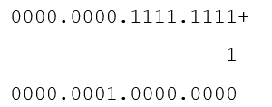
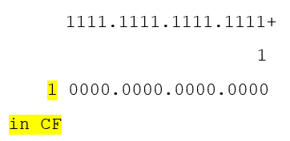
Carry Flag Examples: ADD (2)
On the other hand, if 1 is added to 00FFh in AX, the sum easily fits into 16 bits and the Carry flag is clear:
Example:
mov ax, 0000000011111111b ;00FFh
add ax, 1 ; AX = 0100h, CF = 0
But again adding 1 to FFFFh in the AX register generates a Carry out of the high bit position of AX:
Example:
mov ax, 0FFFFh
add ax, 1 ; AX = 0000, CF = 1
Notes:
On the other hand, if 1 is added to 00FFh in AX, the sum easily fits into 16 bits and the Carry flag is clear:
Example:
mov ax,00FFh
add ax,1 ; AX = 0100h, CF = 0
But adding 1 to FFFFh in the AX register generates a Carry out of the high bit position of AX:
Example:
mov ax,0FFFFh
add ax,1 ; AX = 0000, CF = 1

Slide 7
ADC – add with carry (flag)
ADC Dest, Source; Dest = Dest + Source + prev. Carry (set by previous arithmetic operation)

Slide 8
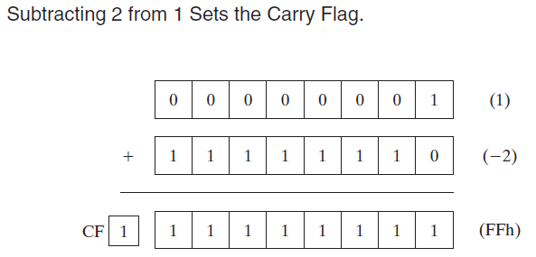
Carry Flag Examples: SUB
A subtract operation sets the Carry flag when a larger unsigned integer is subtracted from a smaller one.
Example:
mov al, 1
sub al, 2 ; AL = FFh, CF = 1
(Internally, the CPU can implement
subtraction as a combination of
negation and addition)
Notes:
Internally, the CPU can implement subtraction as a combination of negation and addition.
The Carry, Zero, Sign, Overflow, Auxiliary Carry, and Parity flags are changed according to the value that is placed in the destination operand.
A subtract operation sets the Carry flag when a larger unsigned integer is subtracted from a smaller one.
Example:
mov al,1
sub al,2 ; AL = FFh, CF = 1

Slide 9
SBB – substract with borrow (content from cf)
SBB Dest, Source; Dest = Dest - Source - prev. Carry (set by previous arithmetic operation)

Slide 10
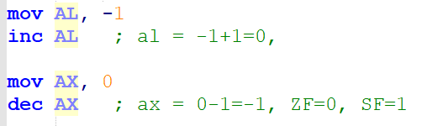
Carry Flag and INC / DEC
2 Exceptions: inc and dec instructions:
Carry flag is not set by inc and dec instructions:
Increment or Decrement a value from a register or from a variable
INC reg/mem ; reg/mem=reg/mem + 1
DEC reg/mem ; reg/mem=reg/mem - 1

Slide 11
Parity Flag
* Indicates even parity of the low 8 bits of the result
– PF is set if the lower 8 bits contain even number 1 bits
In general, it is used for error checking when there is a possibility that data might be altered or corrupted.
– For 16- and 32-bit values, only the least significant 8 bits are considered for computing parity flag value
Examples
mov AL, 53 ;53 = 0011 0101B
add AL, 89 ;89 = 0101 1001B
;al = 142D = 1000 1110B - 4 bits of 1 in result, PF =1
As the result has even number of 1 bits, parity flag is set
Mov bx, 00000000.00000011b pf = 1
Mov bx, 11000000.00000011b pf = 1
Mov bx, 00000000.000000111b, pf = 0

Slide 12
Parity Flag Examples: PF for ADD and SUB
The Parity flag (PF) is set when the least significant byte of the destination has an even number of 1 bits.
Example:
The following ADD and SUB instructions alter the parity of AL:
mov ax, 0000000110001100b
add ax, 0000000100000010b ; AX = 0000000110001110 ; 4 bits = 1 => PF = 1
sub ax, 0000000110000000b ; AX = 0000000100001110 ; 3 bits = 1 => PF = 0
most significant byte
least significant byte

Slide 13
Auxiliary flag
Indicates whether an operation produced a carry or borrow in the low-order 4 bits (nibble) of 8-, 16-, or 32- bit operands (i.e. operand size doesn’t matter)
Examples
mov AL, 43 ;43 = 0010 1011B
add AL, 94 ;94 = 0101 1110B
;137D = 1000 1001B
As there is a carry from the lower nibble, auxiliary flag is set

Slide 14
Examples: Zero Flag
The Zero flag is set when the result of an arithmetic operation is zero.
The following examples show the state of the destination register and Zero flag after executing the operations:
Eg 1:
mov ecx, 1
sub ecx, 1 ; ECX = 0, ZF = 1
Eg 2:
mov eax, 0FFFFFFFFh (eax = -1)
inc eax ; EAX = 0, ZF = 1
inc eax ; EAX = 1, ZF = 0
dec eax ; EAX = 0, ZF = 1
Eg 3:
mov AL,55H ; ZF is still zero
sub AL,55H ; result is 0 ; ZF is set (ZF = 1)
Eg 4:
mov CX,0 ; ZF remains 1
inc CX ; result is 1 ; ZF is cleared (ZF = 0)
Notes:
The Zero flag is set when the result of an arithmetic operation is zero.
The following examples show the state of the destination register and Zero flag after executing the SUB, INC, and DEC instructions:
Example1
mov ecx, 1
sub ecx, 1 ; ECX = 0, ZF = 1
Example 2
mov eax, 0FFFFFFFFh
inc eax ; EAX = 0, ZF = 1
inc eax ; EAX = 1, ZF = 0
dec eax ; EAX = 0, ZF = 1
So if the rezult of the operation is 0, the ZF is set, so ZF=1

Slide 15
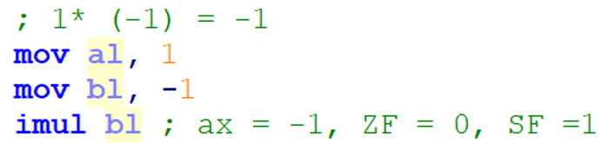
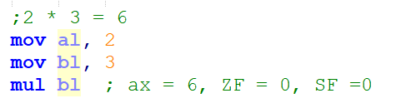
Sign Flag Examples
The Sign flag is set when the result of a signed arithmetic operation is negative.
The Sign flag is a copy of the destination operand’s high bit (simply a copy of the most significant bit of the result)
Ex1 subtracts a larger integer (5) from a smaller one (4):
mov eax, 4
sub eax, 5 ; EAX = -1, SF = 1
Ex2 shows the hexadecimal values of BL when a negative result is generated:
mov bl, 1 ; BL = 01h
sub bl, 2 ; BL = FFh (-1), SF = 1

Slide 16
Overflow flag
The Overflow flag is set when the result of a signed arithmetic operation overflows or underflows the destination operand (OF Indicates out-of-range result on signed numbers)
Range of 8-, 16-, and 32-bit signed numbers
8 bits - 128 to +127
16 bits - 32,768 to +32,767
32 bits -2,147,483,648 to +2,147,483,647

Slide 17
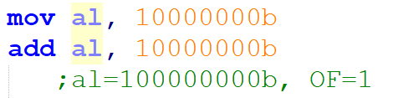
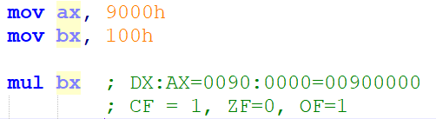
Overflow flag examples
!!! The destination operand value does not hold a valid arithmetic result, and the Overflow flag is set.
The result of the multiplication exceeds the word AX and it produce overflow in the DX:AX
Notes:
The Overflow flag is set when the result of a signed arithmetic operation overflows or underflows the destination operand
For example, we know that the largest possible integer signed byte value is 127; adding 1 to it causes overflow:
mov al,+127
add al,1 ; OF = 1
Similarly, the smallest possible negative integer byte value is 128. Subtracting 1 from it causes underflow.
The destination operand value does not hold a valid arithmetic result, and the Overflow flag is set:
mov al,-128
sub al,1 ; OF = 1

Slide 18
Carry Flag and Overflow Flag
Do not confuse the "carry" flag with the "overflow" flag in integer arithmetic.
Each flag can occur on its own, or both together. The CPU's ALU doesn't care or know whether you are doing signed or unsigned mathematics; the ALU always sets both flags appropriately when doing any integer math.
The ALU doesn't know about signed/unsigned; the ALU just does the binary math and sets the flags appropriately. It's up to you, the programmer, to know which flag to check after the math is done.
In unsigned arithmetic, watch the carry flag to detect errors.
In unsigned arithmetic, the overflow flag tells you nothing interesting.
In signed arithmetic, watch the overflow flag to detect errors.
In signed arithmetic, the carry flag tells you nothing interesting.

Slide 19
Control Flags
The control flags enable or disable certain operations of the microprocessor.
3 control flags in 8086 microprocessor and these are:
Directional Flag (D) – This flag is specifically used in string instructions. If directional flag is set (1), then access the string data from higher memory location towards lower memory location. If directional flag is reset (0), then access the string data from lower memory location towards higher memory location.
Interrupt Flag (I) – This flag is for interrupts. If interrupt flag is set (1), the microprocessor will recognize interrupt requests from the peripherals. If interrupt flag is reset (0), the microprocessor will not recognize any interrupt requests and will ignore them.
Trap Flag (T) –If trap flag is set (1), the CPU automatically generates an internal interrupt after each instruction, allowing a program to be inspected as it executes instruction by instruction. If trap flag is reset (0), no function is performed. TF is used in malware detection programs.

Slide 20
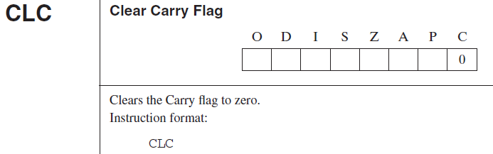
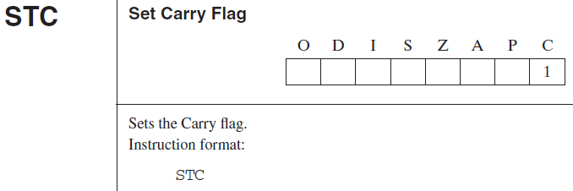
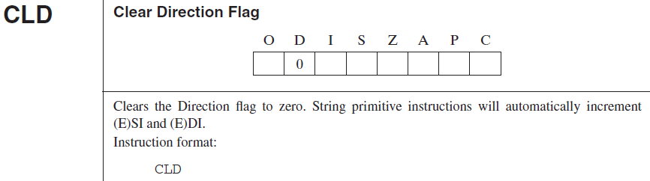
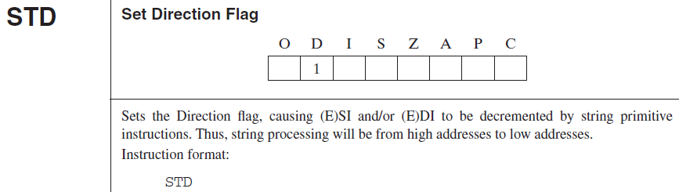
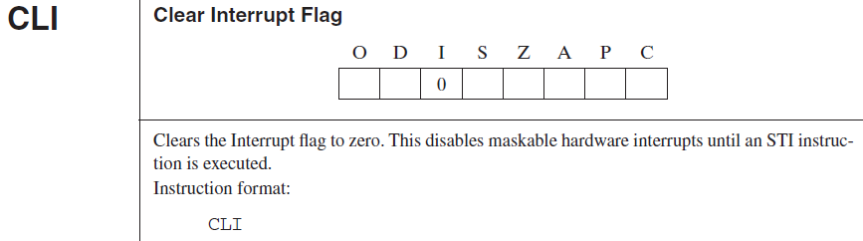
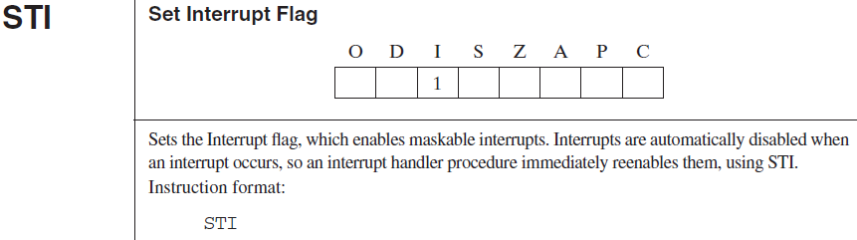
Specific instructions to clear and set the flags values
Notes:
All these instructions are without operands:
CLC – CLEAR CF, BASSICALY fill CF with 0, CLD – CLEAR DF, BASSICALY fill DF with 0, CLI Clear Interrupt Flags, fill the IF with 0.
STC – set CF, BASSICALY fill CF with 1, STD – set DF, BASSICALY fill DF with 1, STI Set Interrupt Flags, fill the IF with 1.
CLD and STD are two instructions that will be used when we will work with strings of bytes/words/doublewords.

Slide 21
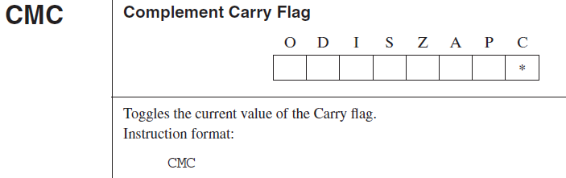
Specific instructions to modify the flag values
Notes:
Complement carry flag is an instruction that can be used to modify (from 0 to 1, or from 1 to 0) the value from CF, according to a particular task.

Slide 22
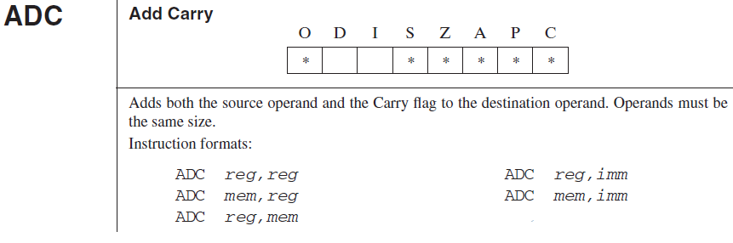
Specific instructions based on CF (1)
MOV ECX, [high_part_of_quadword1]
MOV EBX, [low_part_of_quadword1]
MOV EDX, [high_part_of_quadword2]
MOV EAX, [low_part_of_quadword2]
ADD EAX, EBX
ADC EDX, ECX
a QUADWORD can be saved only in combinations of registers:
In ECX:EBX or in EDX:EAX
So, adding two quadwords:
ECX:EBX+
EDX:EAX
Notes:
There are some particular instructions that work in their computation with the content from CF.
ADC (Add with carry) is an instruction which have to be used when we know that a carry was set:
A good example is to add 2 quadwords, becuase we don’t have a register to save a quadword, we will have to use a combination of 2 register, each of them on 32 bits. We imagine that we join these 2 registers (ecx and ebx) and create a piece of 64 bits.
But if you remember form addition in binary, we added bit by bit stating from right and going to left we kept in mind the carry, so the same mechanism also here: we firstly add ebx and eax and the we add edx and ecx with the Carry.

Slide 23
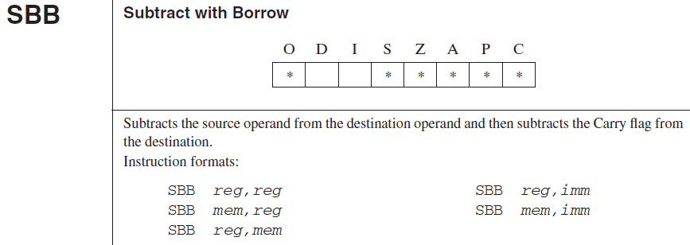
Specific instructions based on CF (2)
a QUADWORD can be saved only in combinations of registers:
In ECX:EBX or in EDX:EAX
So, substracting two quadwords:
ECX:EBX -
EDX:EAX
MOV ECX, [high_part_of_quadword1]
MOV EBX, [low_part_of_quadword1]
MOV EDX, [high_part_of_quadword2]
MOV EAX, [low_part_of_quadword2]
SUB EAX, EBX
SBB ECX, EDX

Slide 24
Other instrctions with Flags: SAHF and LAHF
Load Flags into AH Register (lahf)
Operation
SF:ZF:xx:AF:xx:PF:xx:CF -> AH
Description
Transfers the low byte of the flags word to the AH register: The bits (lsb to msb) are: sign, zero, indeterminate, auxiliary carry, indeterminate, parity, indeterminate, and carry.
(LAHF (Load AH from Flags) copies SF, ZF, AF, PF, and CF to AH bits 7, 6, 4, 2, and 0, respectively. The contents of the remaining bits (5, 3, and 1) are undefined.
The flags remain unaffected.)
Store AH into Flags (sahf)
Operation
AH -> SF:ZF:xx:AF:xx:PF:xx:CF
Description
Loads flags (sign, zero, indeterminate, auxiliary carry, indeterminate, parity, indeterminate, and carry) with values from the AH register.
(SAHF (Store AH into Flags) transfers bits 7, 6, 4, 2, and 0 from AH into SF, ZF, AF, PF, and CF, respectively.)

Slide 25
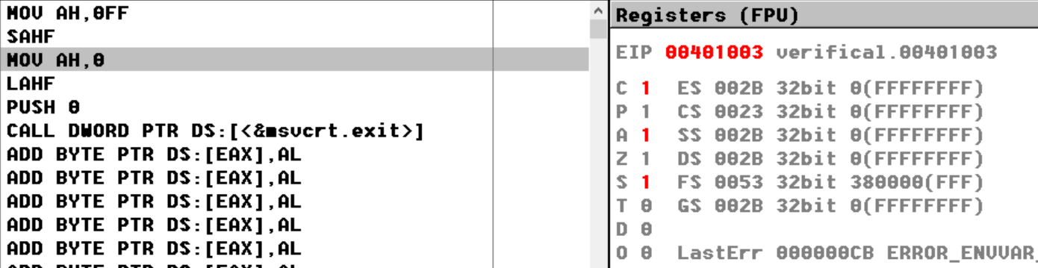
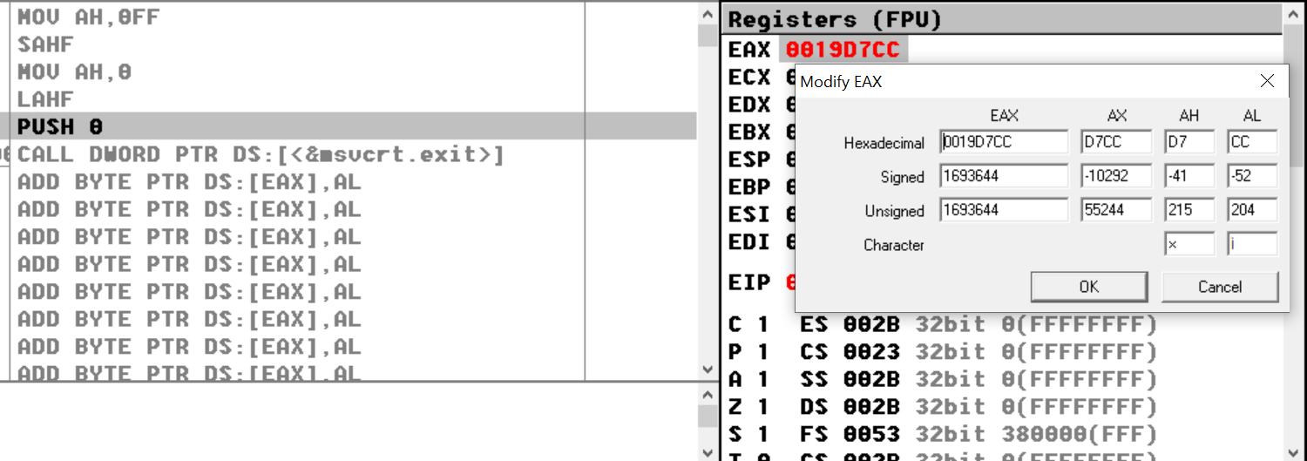

Slide 26
The Conditional Jump Instructions dependent of Flags values
The conditional jumps test one or more flags to see if they match some particular pattern.
If the flag settings match, the instruction transfers to the target location.
If the match fails, the CPU ignores the conditional jump and execution continues with the next instruction.
The conditional jump instructions simply test the setting of the sign, carry, overflow, and zero flags.
The most common way to transfer control in assembly language is to use a conditional jump.
This is a two-step process:
First test the condition.
Then jump if the condition is true or continue to the instruction immediately following the conditional jump if it is false.

Slide 27
Syntax and Effect Jcc
The conditional jmp instructions take the following form:
Jcc label;
The "cc" in Jcc indicates that you must substitute some character sequence that specifies the type of condition to test.
Eg:
Code line1
Code line2
Jcc label1 ;if cc is true the execution line goes to Label1 and if the cc is false the execution line goes to Code line 3
Code line3
Code line4
Label1:

Slide 28
Conditional Jump Instructions That Test Flags
Instruction | Description | Condition
JC | Jump if carry | Carry = 1
JNC | Jump if no Carry | Carry = 0
JZ | Jump if zero | Zero = 1
JNZ | Jump if not zero | Zero = 0
JS | Jump if sign | Sign = 1
JNS | Jump if no sign | Sign = 0
JO | Jump if overflow | Ovrflw = 1
JNO | Jump if no overflow | Ovrflw = 0
JP | Jump if parity | Parity = 1
JPE | Jump if parity even | Parity = 1
JNP | Jump if no parity | Parity = 0
JPO | Jump if parity odd | Parity = 0

Slide 29
Problem:
Choose values for the variables such that Flags will be modified when operations will be executed:
P: a – byte, b – byte c – byte, d - byte (Signed)
if a * b = 0 then compute E = 3 *c
else compute E = -2 *d

